Slide 1
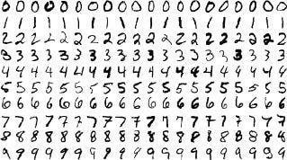
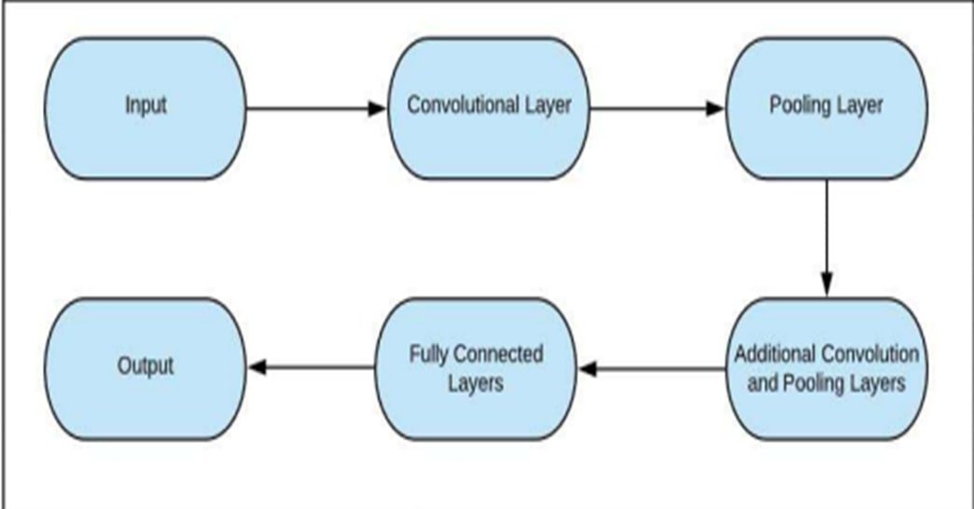
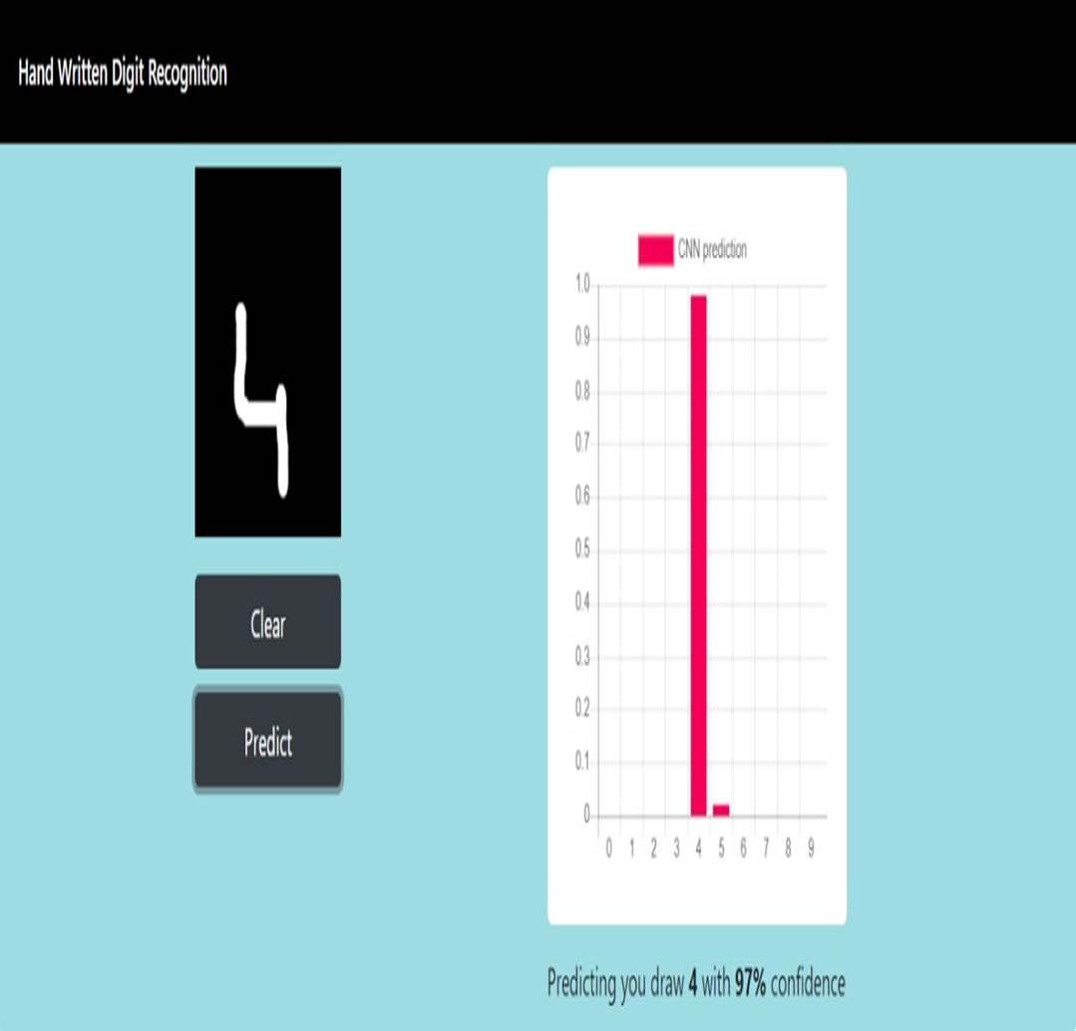
This Scientific Poster Template Is Provided By MakeSigns
Enter A Title And Add Logos To Your Poster
Add Author Names and Information
Include University or Department Names if Needed
Abstract
Dataset
Models
Conclusion
AThe handwritten digit recognition problem becomes one of the most famous problems in machine learning and computer vision applications. Many machine learning techniques have been employed to solve the handwritten digit recognition problem. This paper focuses on Neural Network (NN) approaches. The most three famous NN approaches are deep neural network (DNN), deep belief network (DBN) and convolutional neural network (CNN)..
MNIST dataset consists of handwritten digits from 0 to 9 and has a training set of 60,000 samples, and a test set of 10,000 samples. The digits are binary 28x28 pixels. we import all the needed modules for training our model. We can easily import the dataset and start working on that because the Keras library already contains many datasets and MNIST is one of them. We call mnist.load_data() function to get training data with its labels and also the testing data with its labels.
We use CNN (convolution neural network) for this project
We will use the Adadelta optimizer for the model compilation.
We use model architecture as keras sequential
Cross entropy is used as loss function
To start the training of the model we can simply call the model.fit() function of Keras. It takes the training data, validation data, epochs, and batch size as the parameter.
The training of model takes some time. After succesful model training, we can save the weights and model definition in the ‘mnist.h5’ file.
.
AHere we demonstrate a model which can recognize handwritten digit. Later it can be extended for character recognition and real-time person’s handwriting. Handwritten digit recognition is the first step to the vast field of Artificial Intelligence and Computer Vision. As seen from the results of the experiment, CNN proves to be far better than other classifiers. The results can be made more accurate with more convolution layers and more number of hidden neurons. It can completely abolish the need for typing. Digit recognition is an excellent prototype problem for learning about neural networks and it gives a great way to develop more advanced techniques of deep learning. In future, we are planning to develop a real-time handwritten digit recognition system..
Introduction
Handwritten digit recognition is the ability of a computer to recognize the human handwritten digits from different sources like images, papers, touch screens, etc, and classify them into 10 predefined classes (0-9). This has been a topic of boundless-research in the field of deep learning. Digit recognition has many applications like number plate recognition, postal mail sorting, bank check processing, etc [2]. In Handwritten digit recognition, we face many challenges because of different styles of writing of different peoples as it is not an Optical character recognition. This research provides a comprehensive comparison between different machine learning and deep learning algorithms for the purpose of handwritten digit recognition.
Output
Add your information, graphs and images to this section.

